Slide 1
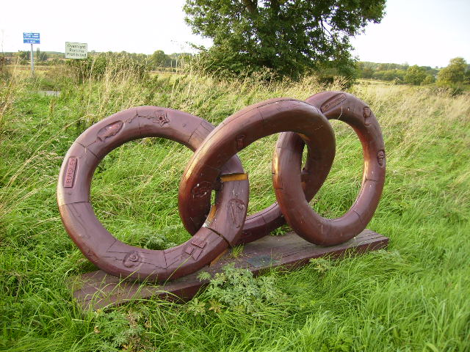
Engaging with your audience
Teresa MacKinnon
Principal Teaching Fellow,
Language Centre, University of Warwick
Notes:
Value of linking

Slide 2
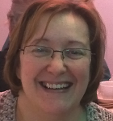
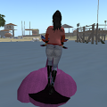
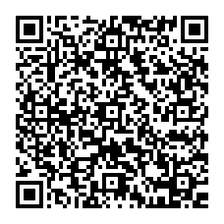
Who am I?

Slide 3
Vital preparation.
Identify your persona.
Review your communications strategy (CS).
Identify your audiences.
Clarify the purpose of each communication channel.
Connect with your networks.
Contribute, curate and nurture.
Analytics to inform your CS.
Notes:
Social media use is not trivial, takes time and thought to do well.
Start with a review of existing online presence (later slide)
What do you have to say? What are your USPs? How do you present those – use of images/choice of channels
Connect everything so that your audience has choices.
If management is a shared entrerprise expect it to take longer, your aim in each channel is a coherent presence, consider different channels for different roles.
Networks include own academics/their networks – support their work as it contributes to your brand.

Slide 4
Four steps to improving your online presence
Do you
have an
online
presence?
Do you
know where it is coming from?
Have you
Googled
yourself
recently?
Have you
checked all
your online
profiles are
up to date?
Fantastic!
You monitor
and
maintain
your online
presence
YES
YES
YES
YES
NO
NO
NO
NO
NO
Start
assessing
your online
presence
and decide
what you
want
Look at your
profiles and online identities
You and
everyone
you know
cannot have been online, ever!
Are you
sure?
What more can I do?
Step 2:
Keep all profiles
up to date
Communicate
and connect: Blog, tweet and
comment
Step 1:
Search for
yourself & check
your impact
Share your outputs
Step 3:
Self archive and
share what you
can
Step 4:
Connect &
interact online

Slide 5
Notes:
Choosing your channels – emerge from analysis but you will need to be multi-modal
How participatory? G+ community vs G+ page (brand/event?)

Slide 6
Notes:
Management consoles
Using your interactions to create streams #
Set up connections ie FB to twitter

Slide 7
A few final words of advice:
Do’s
Don’t’s
Produce a coherent, authentic “voice”
Contribute and collaborate
Play nicely
Keep all channels connected to your central mission
Support your community
Keep it timely and vibrant
Use analytics to inform
SHOUT!
Over use # and personal chit chat
Preach
Alienate your audience
Assume everyone will flock to you

Slide 8
Thank you for listening!
Please follow WarwickLanguage on twitter and youtube
and UCML on twitter and Facebook. ☺
Further information and networks:
AULC Resources management group on linkedin
Pearltree resources for social media
Twitter for linguists: #mfl #mfltwitterati #languages and follow lists from @warwicklanguage
Managing your identity slideshare presentation for HEA “Changing the learning landscape.”

